Slide 2
Overview
Part 1 – The Design Space
  Integrated Circuits
    Levels of Integration
  CMOS Circuit Technology
    CMOS Transistor Models
    Circuits of Switches
    Fully Complementary CMOS Circuits
    Technology Parameters
Part 2 – Propagation Delay and Timing
Part 3 – Asynchronous Interactions
Part 4 - Programmable Implementation Technologies

Slide 3
Integrated Circuits
Integrated circuit (informally, a “chip”) is a semiconductor crystal (most often silicon) containing the electronic components for the digital gates and storage elements which are interconnected on the chip.
Terminology - Levels of chip integration
  SSI (small-scale integrated) - fewer than 10 gates
  MSI (medium-scale integrated) - 10 to 100 gates
  LSI (large-scale integrated) - 100 to thousands of gates
  VLSI (very large-scale integrated) - thousands to 100s of millions of gates

Slide 4
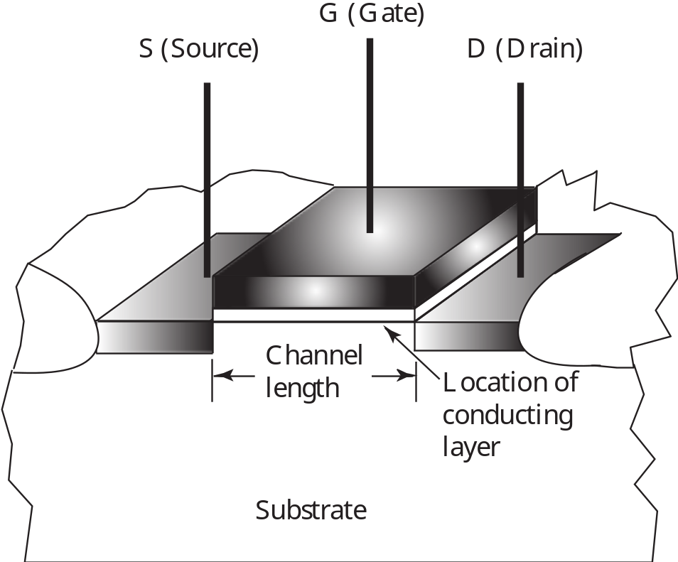
MOS Transistor
0
V
olts
0
V
olts
V
DD
V
olts
n-Channel
T
ransistor
:
OFF - no D-to-S Cur
r
ent

Slide 5
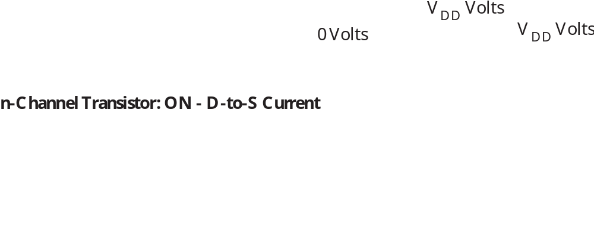
MOS Transistor

Slide 6
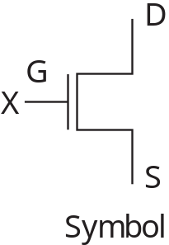
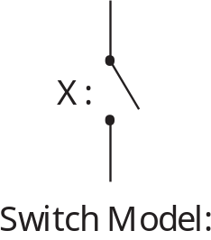
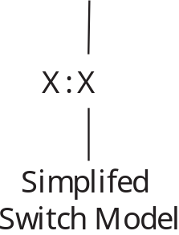
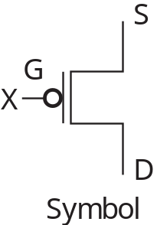
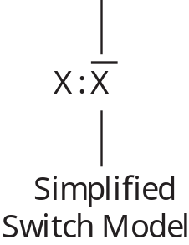
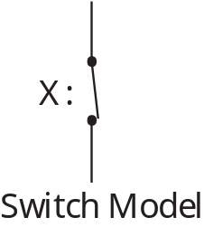
Switch Models for MOS Transistors
n-Channel – Normally Open (NO) Switch Contact
p-Channel – Normally Closed (NC) Switch Contact

Slide 7
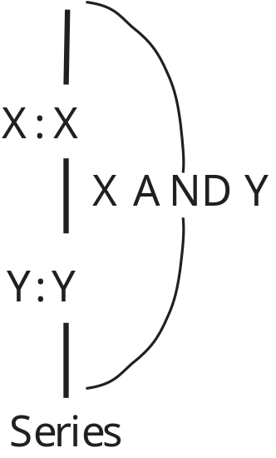
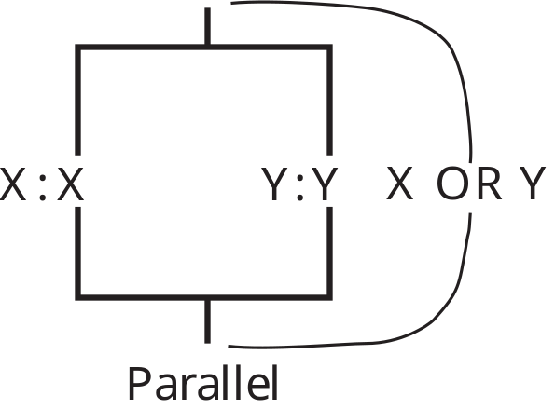
Circuits of Switch Models
Series
Parallel

Slide 8
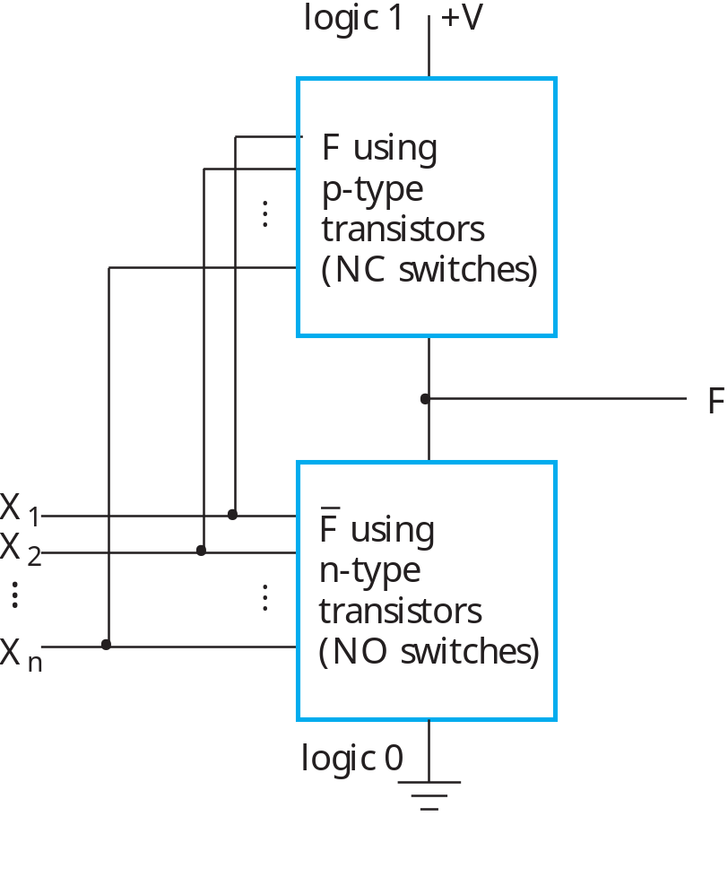
Fully-Complementary CMOS Circuit
Circuit structure for fully-complementary CMOS gate

Slide 9

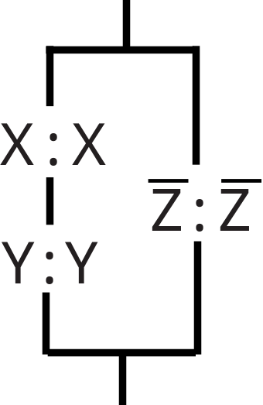
CMOS Circuit Design Example
Find a CMOS gate with the following function:
Beginning with F0, and using F
The switch model circuit in terms of NO switches:
Notes:
This example goes beyond the material given in the text which focuses on primitive gates to material covered in the reading supplement More on CMOS Circuits.
It covers the very simplest of complex gates and should be understandable to students even without studying the supplement.

Slide 10
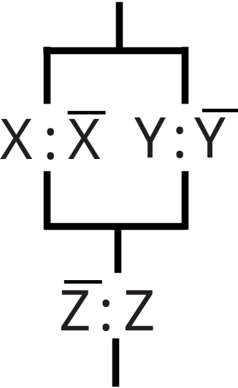
CMOS Circuit Design Example
The switch model circuit for F1 in terms of NC contacts is the dual of the switch model circuit for F0:
The function for this circuit is:
which is the correct F.

Slide 11
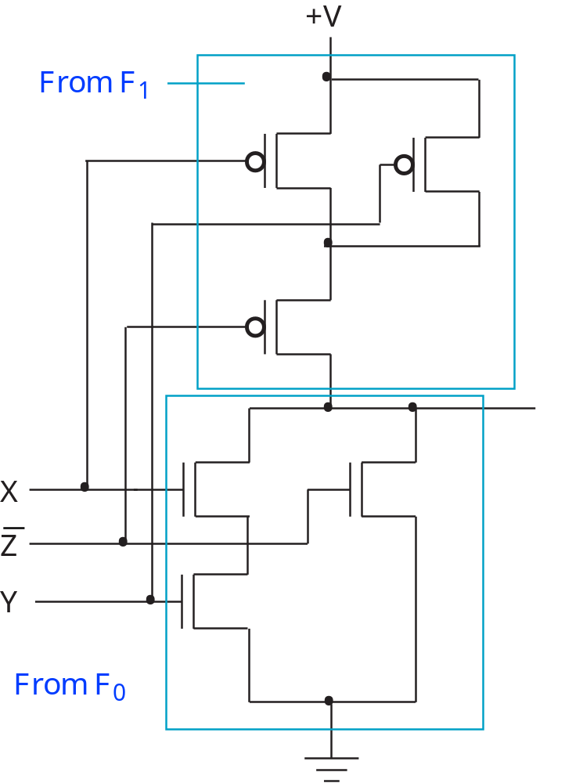
CMOS Circuit Design Example
Replacing the
switch models
with CMOS
transistors;
note input
Z must be
used.

Slide 12
Technology Parameters
Specific gate implementation technologies are characterized by the following parameters:
  Fan-in – the number of inputs available on a gate
  Fan-out – the number of standard loads driven by a gate output
  Logic Levels – the signal value ranges for 1 and 0 on the inputs and 1 and 0 on the outputs (see Figure 1-1)
  Noise Margin – the maximum external noise voltage superimposed on a normal input value that will not cause an undesirable change in the circuit output
  Cost for a gate - a measure of the contribution by the gate to the cost of the integrated circuit
  Propagation Delay – The time required for a change in the value of a signal to propagate from an input to an output
  Power Dissipation – the amount of power drawn from the power supply and consumed by the gate

Slide 13
Fan-out
Fan-out can be defined in terms of a standard load
  Example: 1 standard load equals the load contributed by the input of 1 inverter.
  Transition time -the time required for the gate output to change from H to L, t_{HL}, or from L to H, t_{LH}
  The maximum fan-out that can be driven by a gate is the number of standard loads the gate can drive without exceeding its specified maximum transition time

Slide 14
Cost
In an integrated circuit:
  The cost of a gate is proportional to the chip area occupied by the gate
  The gate area is roughly proportional to the number and size of the transistors and the amount of wiring connecting them
  Ignoring the wiring area, the gate area is roughly proportional to the gate input count
  So gate input count is a rough measure of gate cost
If the actual chip layout area occupied by the gate is known, it is a far more accurate measure

Slide 15
Terms of Use
All (or portions) of this material © 2008 by Pearson Education, Inc.
Permission is given to incorporate this material or adaptations thereof into classroom presentations and handouts to instructors in courses adopting the latest edition of Logic and Computer Design Fundamentals as the course textbook.
These materials or adaptations thereof are not to be sold or otherwise offered for consideration.
This Terms of Use slide or page is to be included within the original materials or any adaptations thereof.

